Slide 1

ServiceStack.Net
An introduction sdg COP demo

Slide 2
Paul Thompson
Consultant, SDG
@paladincoder
paul.thompson@solutiondesign.com
http://www.solutiondesign.com
Notes:
Joined sdg in july
Currently at Patterson – chance to convert them to servicestack

Slide 3
What is ServiceStack.Net?
REST Web Service Framework
.NET and MONO
Web Services done right, REST services done easy

Slide 4

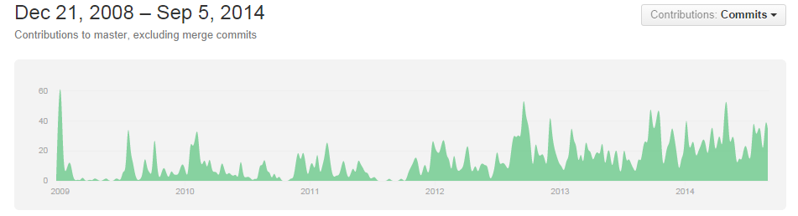
Servicestack History
Invented by Demis Bellot, Started as open source,
#2 github project in 2013

Slide 5


Slide 6
Design Goals
Simple and Fast
Model-driven
Write once, support for all XML, JSON, SOAP...
No XML Config, No Code-gen required
First class cross-platform support for OSS/Linux

Slide 7
Simple On the Server
C# Model-driven development
No Artificial layers or constructs
Complete control over HTTP Headers and serialized output
Endpoint ignorant
C# only, code to interfaces and types not specific formats or endpoints
Same DTO used in strong-typed client API
Notes:
C# Model-driven development,
Define Web Service API using YOUR strong-typed DTOs
No Code-gen

Slide 8

Demo
You had me at hello (World)

Slide 9
Simple on the Client
C# client can call any web service at any endpoint
XML, JSON, JSV and Soap11/Soap12
Sync and Async client support

Slide 10

Fast
Built on raw IHttpHandlers
No runtime reflection or regular expressions
Built-in super fast IOC Container
Fastest JSON, JSV serializers for .NET
Notes:
ServiceStack.Text is 3.6x faster DataContractJsonSerializer
Several benchmarks exist. There are quite a few newer serializers faster now on mono, but ss beats datacontractseralizer for Json.
Uses DataContractSerializer built in .NET for XML serialization (use attributes)

Slide 11

Best Practices
Influenced by Martin Fowlers Data Transfer Object Pattern
Encourage batch-full, re-usable web services
Discourage chatty, client-specific APIs
Importance of a Coarse-grained, well-defined API
Resilient serializers with better versioning support
Decoupling of message from operation and endpoint
Clean separation of DTO from implementation

Slide 12
C# and HTTP as DRY as possible
Develop Service using only C# POCO types
Same service with no config or code-gen
Strong-typed Request DTO
Can return anything
Any DTO object -> serialized to Response Content-Type
HttpResult, HttpError for Customized HTTP response
String, Stream, IStreamWriter
Notes:
Callable via REST, RPC POX/J or SOAP endpoints
Callable on any format (XML, JSON, SOAP, JSV, CSV, HTML)
Can process HTTP File Upload multipart/form-data
HTTP GET QueryString, HTTP POST DTO Content-Type (i.e. XML, JSON, etc), HTTP FORM POST x-www-form-urlencoded

Slide 13
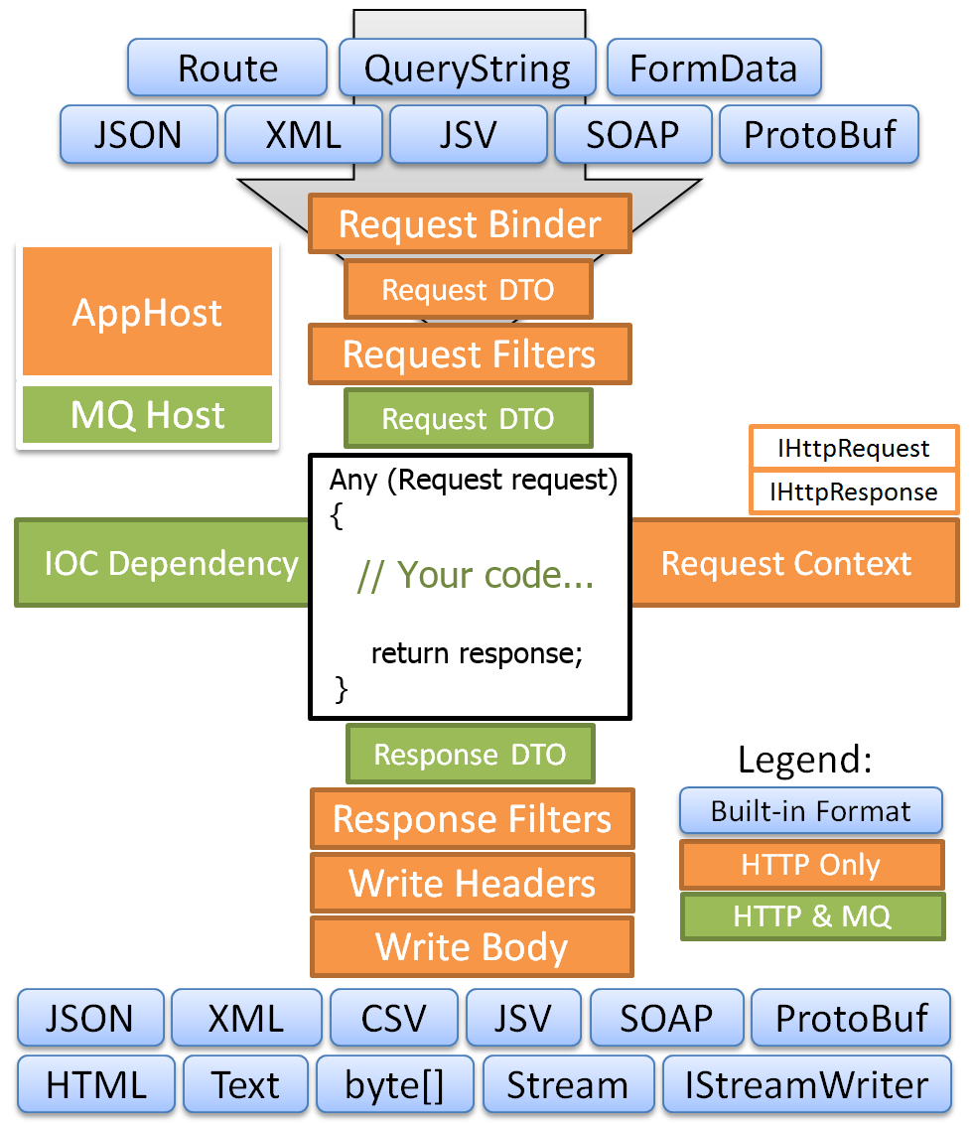
Architecture
POCO Based messaging
Request/Response or Message Queuing
Built on top of Raw ASP.NET IHttpHandler
Notes:
POCO with route information in, response POCO out.

Slide 14
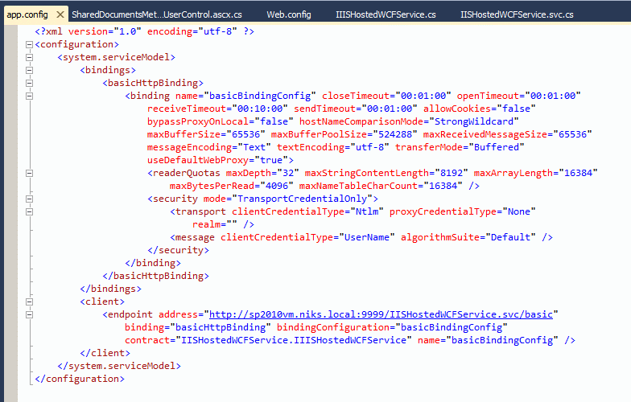
“No” Config
Very little web.config work required with acceptable defaults
Connection strings
Http handler declaration
Additional 3rd party library configuration
Routes are all handled by POCO attributes

Slide 15
Smart
Serializes C# Exceptions into your Response DTO
Auto-generated web services metadata api page
Links to XSDs and WSDLs
Auto HTML5 JSON Report format
Quickly visualize web service data
Generates a self-contained snapshot of web service data

Slide 16
DEMO

Slide 17
Cross platform - Run in .NET and MONO
Supports both ASP.NET and HttpListener hosts:
Runs on Windows with .NET 3.5, 4.0, 4.5
IIS 6/7/8+ (uses IHttpHandler)
Console App or Windows GUI
Windows Service
Linux/OSX with MONO

Slide 18
Questions?

